Slide 1
AB 705 Deep dive
Leigh Anne Shaw, David Hasson, Melissa Matthews, Jarrod Feiner

Slide 2
Timeline & f.a.q.

Slide 3
2017
AB 705 is drafted
1 yr timeline to enter & complete transfer-level Engl & Math
2018
No qualifications for English language learners or students w/ disability
ESL faculty insert language to protect credit ESL opportunities for students
AB 705 signed into law; 2 implementation teams, 2 timelines
Fall 2019 – Engl/Math compliance
Fall 2020 – ESL compliance
AB 1805 (Irwin) – Students will be made aware of their right to enter transfer-level English (ESL added “and credit ESL”)
Default Placement Rules issued – many colleges adopted to use for placement

Slide 4
Are placement tests illegal?
Yes & No. Colleges may NOT use placement tests as the means to place students into or exclude students from a course. Colleges are required to use multiple measures for placement.
BOG is approval authority: does not want to approve new tests
Colleges might be able to give placement tests as advisories.
ESL may use placement tests through Fall 2019 for placement into Spring 2020.

Slide 5
Are pre-transfer (remedial) English and math classes illegal?
NO. Colleges may offer as many English and math classes as they wish. Colleges may not PLACE students into a sequence whereby students could not enter and complete transfer-level in 1 year (3 years for ESL). Students may place themselves into whatever English or math class they wish.

Slide 6
Do International Students get placed according to English multiple measures?
NO. International students take the TOEFL as a requirement to enter the U.S. Skyline uses the TOEFL to place students into transfer-level or ESOL coursework. Further guidance will be issued on this.

Slide 7
Are pre-requisites gone now?
The ASCCC has cautioned against removing any prerequisites at this time, as this will (and has done) jeopardize transfer agreements; more info forthcoming
English and math are looking at different ways to determine pre-req achievement

Slide 8
What do content faculty need to know?
The students in your class may be adjusting to placement into transfer-level English and math
Content faculty may need to adjust course outlines according to the new placement processes
English language learners may benefit from being encouraged to take ESOL classes
All students may benefit from tutoring
Content faculty may wish to partner with English, math, and ESOL to construct co-requisite or contextualized support courses

Slide 9
Math & DATA

Slide 10
3 Levels below | Persistence | 2 Levels below | Persistence | 1 Level below | Persistence | Transfer Level | Pathway Throughput
60% | 80% | 60% | 80% | 60% | 80% | 60% | 6.6%
 |  | 60% | 80% | 60% | 80% | 60% | 13.8%
 |  |  |  | 60% | 80% | 60% | 28.8%

Slide 11
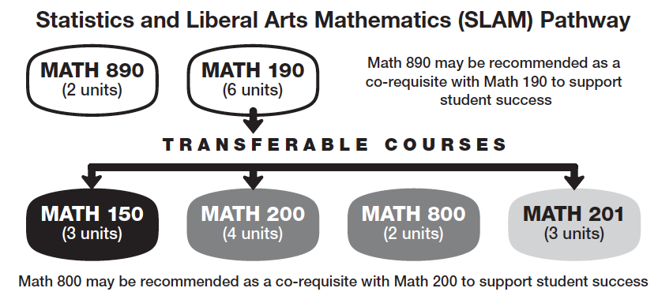
SLAM Pathway
SLAM Level | HSGPA | Default Rec | Expected success w/out co-req | Co-req
1 | HS Alg 1/ Intergrated Math 2 not taken | Path to Statistics MATH 190 | Low | Math 890 strongly rec’d
2 | HS Alg 1/ Integrated Math 2 w/ a grade ≤ C- |  | Moderate | Math 890 rec’d
3 | Less than 2.3 | Math for Elem School Teachers MATH 150 Statistics MATH 200 Math in Society MATH 201 | 29% | Math 800 strongly rec’d
4 | 2.3 to 2.9 |  | 50% | Math 800 Rec’d
5 | 3.0 or greater |  | 75% | Math 800 optional
Statistics and
Liberal
Arts
Mathematics
&
Exploring students

Slide 12
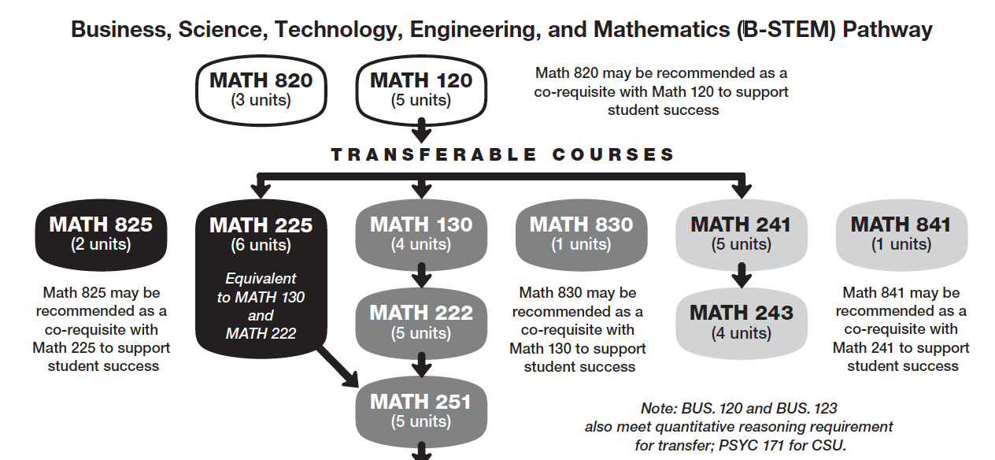
B-STEM Pathway
SLAM Level | HSGPA | Default Rec | Expected success w/out co-req | Co-req
1 | No HS Alg 2/ Intergrated Math 3 | Intermediate Algebra MATH 120 | Low | Math 820 strongly rec’d
2 | HS Alg 2/ Integrated Math 3 w/ a grade ≤ C- |  | Moderate | Math 820 rec’d
3 | Less than 2.6 & no HS Pre-Calc | Trigonometry MATH 130 Path to Calculus MATH 225 Applied Calculus I MATH 241 | 28% | Math 825, 830, 841 strongly rec’d
4 | 2.6 to 3.3 or took HS Pre-Calc |  | 53% | Math 825, 830, 841 rec’d
5 | 3.4 or greater or took HS Calc |  | 75% | Math 825, 830, 841 option
Business
Science
Technology
Engineering
&
Mathematics

Slide 13
1 Level Below | Persistence | Transfer Level | Pathway Throughput
80% | 90% | 80% | 57.6%
75% | 90% | 75% | 50.6%
70% | 90% | 70% | 44.1%
65% | 90% | 65% | 38.0%
Increase completion and persistence through co-requisites, DLAs, EAC – Gateway to Math, STEM Center, Supplemental Instruction, embedded tutoring, embedded counseling, Math Jam

Slide 14
Impact on some students with disabilities

Slide 15
English
Group | HS GPA | Placement
1 | ≥ 2.6 | ENGL 100
2 | 1.9 – 2.6 | ENGL 105 (including additional academic & concurrent support)
3 | < 1.9 | ENGL 105 (including additional academic & concurrent support)
Oct. 30, 2018 Guidance Memo from SMCCCD

Slide 16
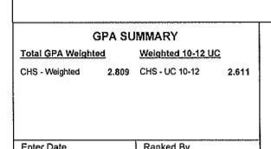

Slide 17
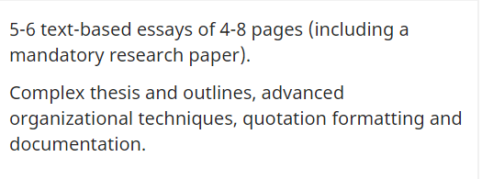
English
Group | HS GPA | Placement
1 | ≥ 2.6 | ENGL 100
2 | 1.9 – 2.6 | ENGL 105 (including additional academic & concurrent support)
3 | < 1.9 | ENGL 105 (including additional academic & concurrent support)
Oct. 30, 2018 Guidance Memo from SMCCCD

Slide 18
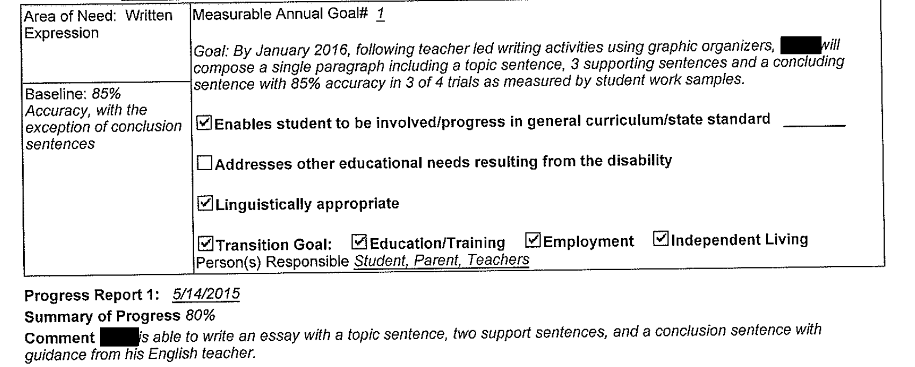
Spring, Senior Year IEP
ENGL 828
ENGL
846
ENGL
105
ENGL 100

Slide 19
SUCCESS VS. ACCESS
High schools – follow IDEA, focus is on SUCCESS
Colleges – follow Section 504 & ADA, focus is on ACCESS

Slide 20
Accommodations are not enough to fill the gap.
No modification of curriculum at the college
Students need to build a foundation in classes appropriate to their skill level before moving into transfer level courses
We can offer foundation building courses and stay in compliance with AB 705

Slide 21
Accelerated
Developmental
Education
(ADE)
Educational Access Center – Gateway
AB 705 Response
The Learning Commons
ENGL 846
ENGL 105
MATH 190 + 890
MATH 120 + 820
Co-req’s
Directed Learning Activities
(DLAS)
Faculty Training
= Persistence

Slide 22
DOES OUR AB 705 RESPONSE REFLECT Skyline’s VALUES?

Slide 23
Vision Statement
Skyline College inspires a global and diverse community of learners to achieve intellectual, cultural, social, economic and personal fulfillment.

Slide 24
Open Access
We are committed to the availability of quality educational programs and services for every member of our community regardless of level of preparedness, socioeconomic status, gender, gender expression, sexual orientation, cultural, religious, or ethnic background, or disability status. We are committed to providing students with open access to programs and responsive student services both in person and online that enable them to advance steadily toward their goals.

Slide 25
Student Success and Equity
We value students’ success in achieving their goals, on time, and strengthening their voices as they transform their lives through their educational experience. We aim to identify and address equity gaps through evidence-based research to ensure that each student has the opportunity to succeed.

Slide 26
Request that Academic Senate Affirms…

Slide 27
The Academic Senate affirms the need to offer limited English pretransfer offering to tier 3 students (HSGPA < 1.9) and/or students with significant modification of their high school curriculum
The Academic Senate affirms the need for professional development that will allow faculty and counseling to case manage tier 2 and 3 students (HSGPA < 2.6)
The Academic Senate affirms the need for professional development surrounding the affective domain – especially – for tier 2 and 3 students (HSGPA < 2.6)
The Academic Senate affirms the need for the creation of Directed Learning Activities (DLAs) that will address skill gaps across the board
The Academic Senate affirms support of credit ESL with sufficient levels and sections to adequately serve the population needing language instruction

