Slide 1
SEEED Stewardship for Equity, Equal Employment and Diversity
Hiring Subcommittee
(Nina Floro, Linda Allen, Pat Tyler, John Mosby, Lucia Lachmayr)

Slide 2
SEEED Committee’s Overall Focus Question
How do our practices and processes in connecting, entry, and progress and completion impact campus equity and student success?

Slide 3
Subcommittee’s Hiring Question
How do our current hiring practices assist or exclude in the attracting/hiring/retaining of faculty, staff, administrators reflective of our student population?

Slide 4
San Mateo Demographics by Ethnicity
Source: County of San Mateo FY 2010-12 Recommended Budget

Slide 5
San Francisco Demographics by Ethnicity
One race | 93.5%
White | 48.5%
Asian | 33.3%
Black or African American | 6.1%
American Indian and Alaska Native | 0.2%
Native Hawaiian and Other Pacific Islander | 0.4%
Some other race | 6.6%
Two or more races | 4.7%
Hispanic or Latino (of any race) | 15.0%
Source: http://www.bayareacensus.ca.gov “"Demographic Profile Bay Area Census"

Slide 6
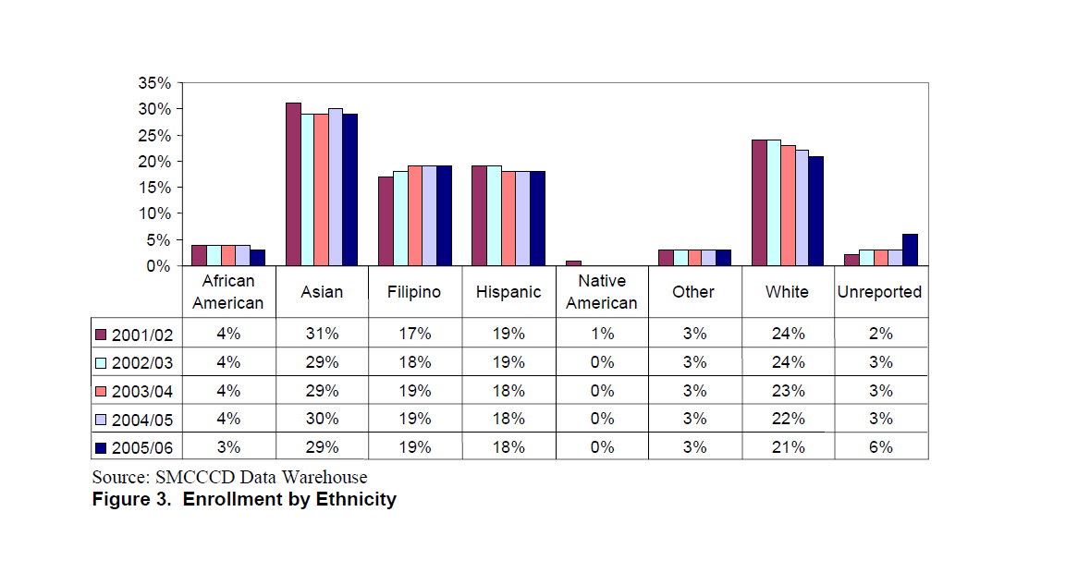
Skyline College Diversity Numbers
Student Population

Slide 7
San Mateo County Community College District—Skyline College 2010-2011 EEO Summaries for Full-Time/Permanent New Hires (reassignments of existing employees not included)
Skyline | 1 - 4 Hispanic /Latino | 5 - 13 Asian | 14 - Black or African American | 15 - American Indian / Alaskan Native | 16 - 19 Pacific Islander | 20 - White | Two or More | Not Disclosed | TOTAL | % of Total
Female | 3 | 3 | 0 | 0 | 0 | 4 | 1 | 0 | 11 | 55.00%
Male | 0 | 2 | 1 | 0 | 0 | 3 | 1 | 2 | 9 | 45.00%
Total | 3 | 5 | 1 | 0 | 0 | 7 | 2 | 2 | 20 | 100.00%
% of Total | 15.00% | 25.00% | 5.00% | 0.00% | 0.00% | 35.00% | 10.00% | 10.00% | 100.00%

Slide 8
Percentage of New Hires compared to Students and our Local Populations
 | Newly hired Staff, Faculty, Administration | Skyline Students | San Mateo | San Francisco
White | 35 | 21 | 44.7 | 48.5
Asian | 25 | 23 | 22.6 | 33.3
African American | 5 | 4 | 3.3 | 6.1
Latino | 15 | 19 | 25 | 15
American Indian | 0 | 0.1 | 0.25 | 0.2
Filipino | 0 | 17 | (approx. 33 in Daly City & 16.5 in South SF) 6.9 | 5

Slide 9
Hiring Committee Questionnaire

Slide 10
Survey Results
Surveys distributed to all full time Skyline College employees
Respondents = 49
Total Complete surveys 45

Slide 11
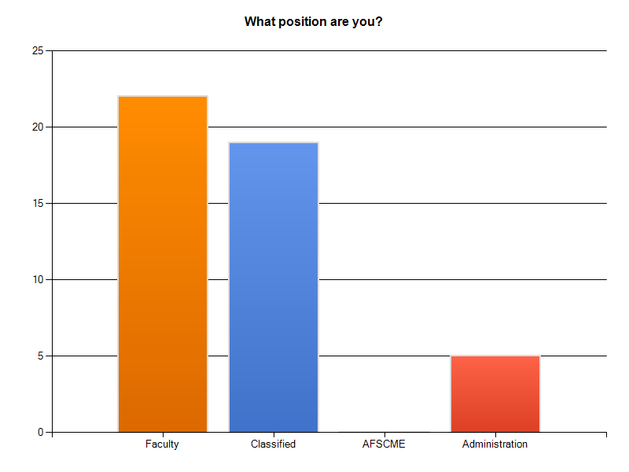
Question 1

Slide 12
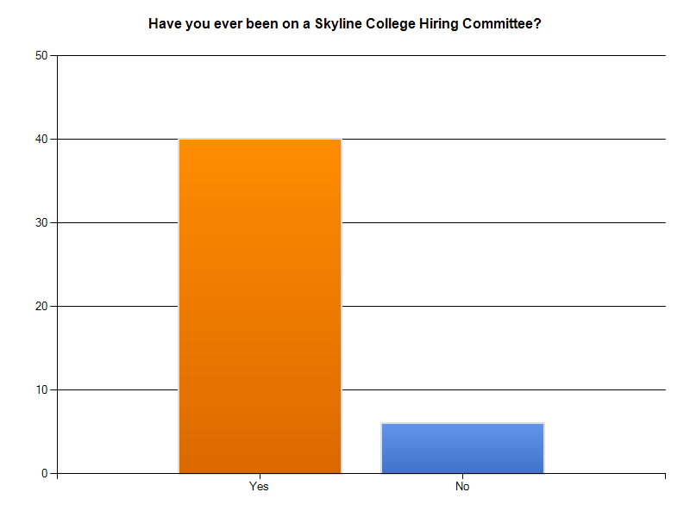
Question 2

Slide 13
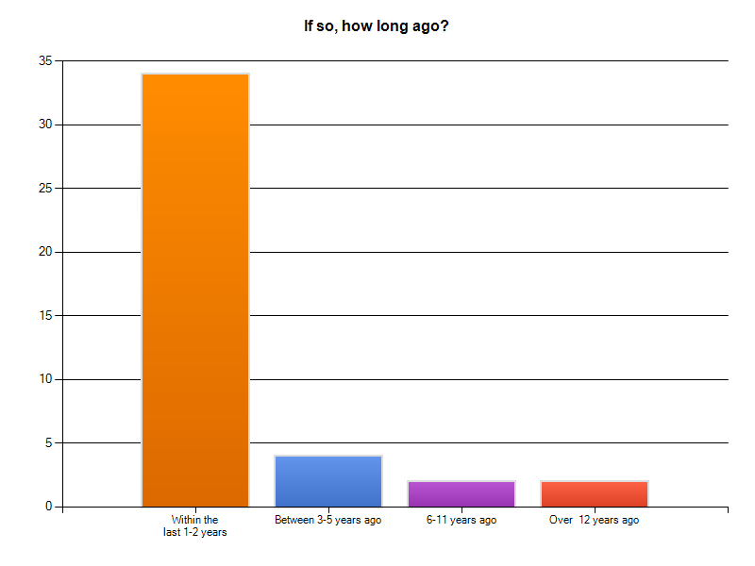
Question 3

Slide 14
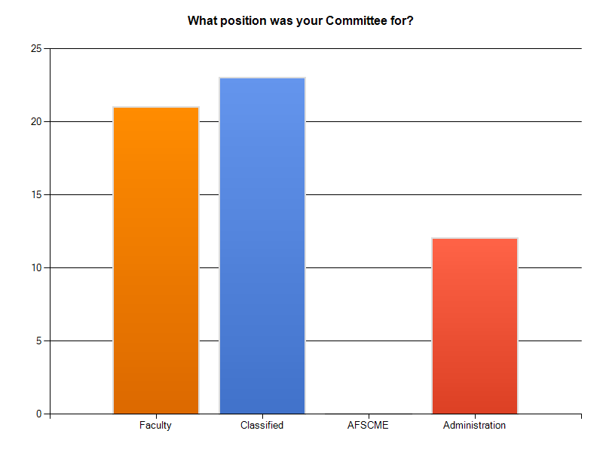
Question 4

Slide 15
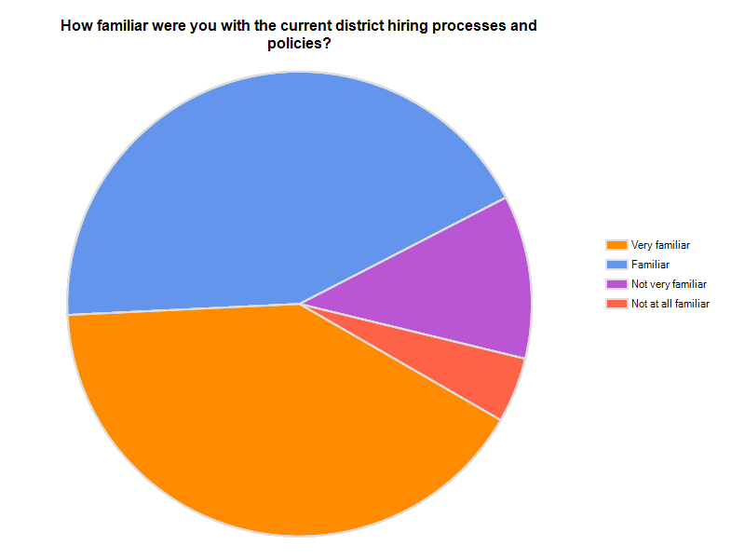
Question 5

Slide 16
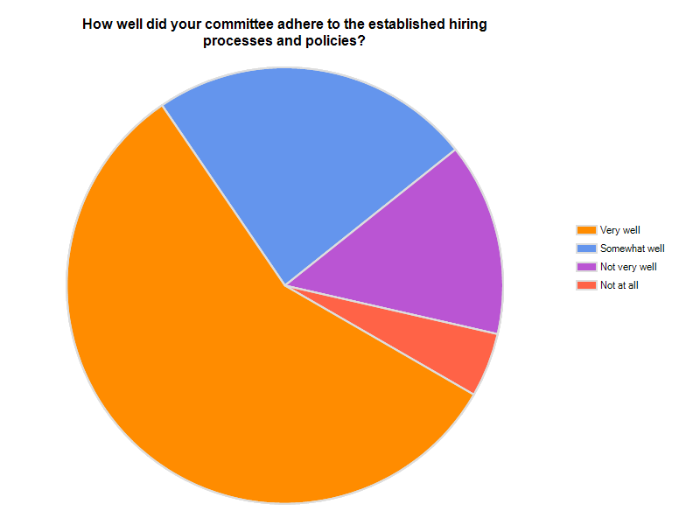
Question 6

Slide 17
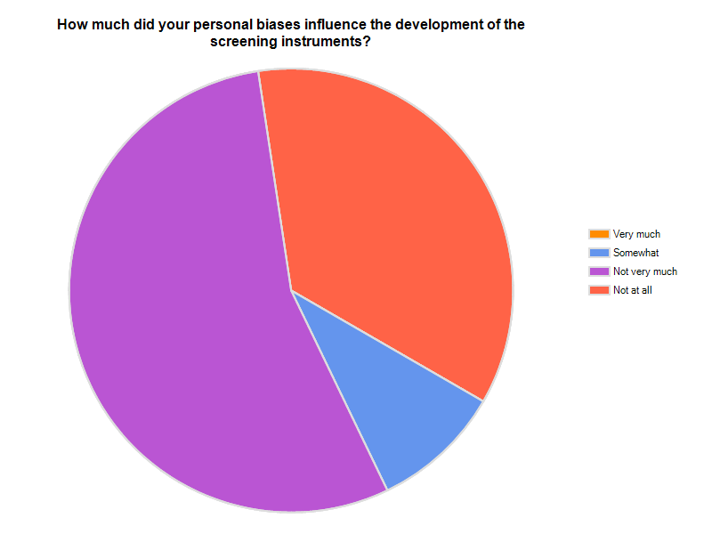
Question 7

Slide 18
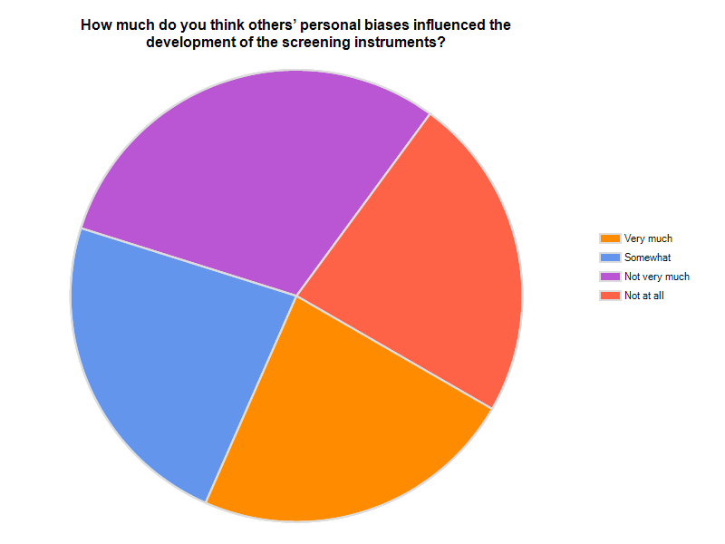
Question 8

Slide 19
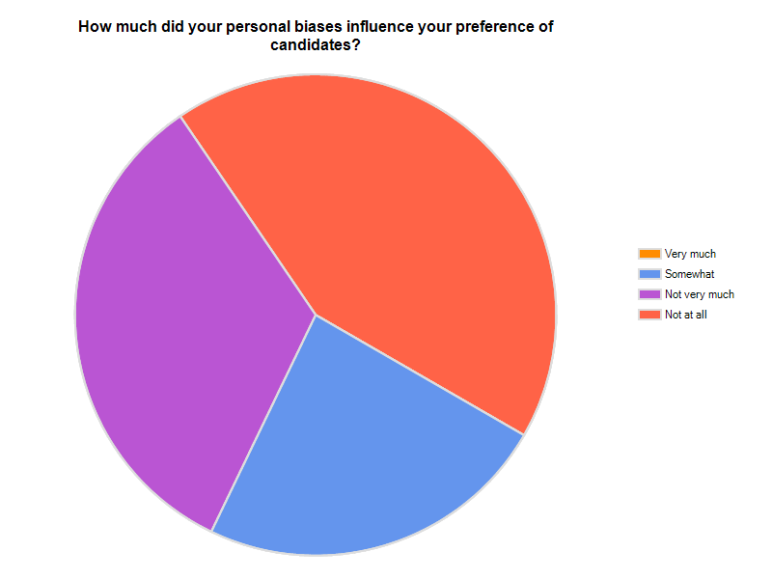
Question 9

Slide 20
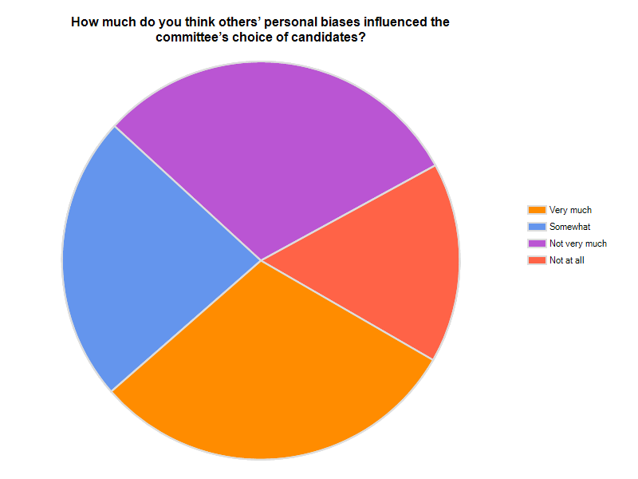
Question 10

Slide 21
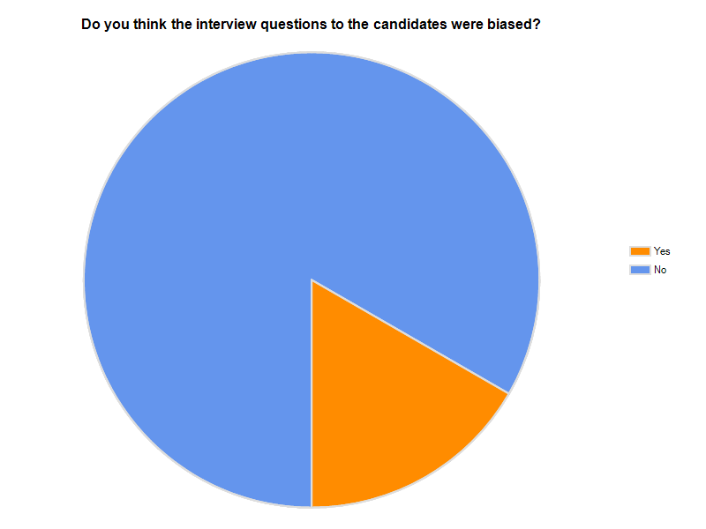
Question 11

Slide 22
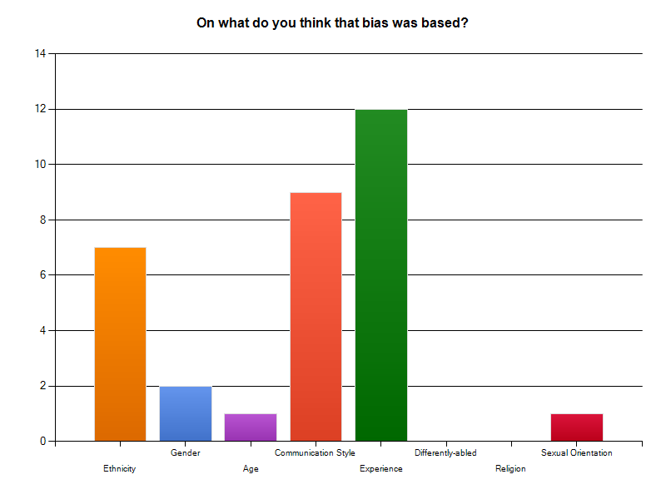
Question 12

Slide 23
Open Ended Responses
4 Basic Themes

Slide 24
Lack of Transparency
Personal relationships biased candidate selection (In-house candidates seen as getting preference)

Slide 25
Process
Requirements too narrow for position/requirements prioritized or tailored to specific candidate
Process is very clear and transparent

Slide 26
Administrative
Committees lack power to decide final candidate
Managers not going through the proper vetting process

Slide 27
Survey itself
Biased survey
Survey not comprehensive enough

Slide 28
Thank You! Your thoughts?...

