Slide 1
CURRICULUM & PEDAGOGY
What practices and processes in algebra sequence impact equitable student success in statistics?

Slide 2
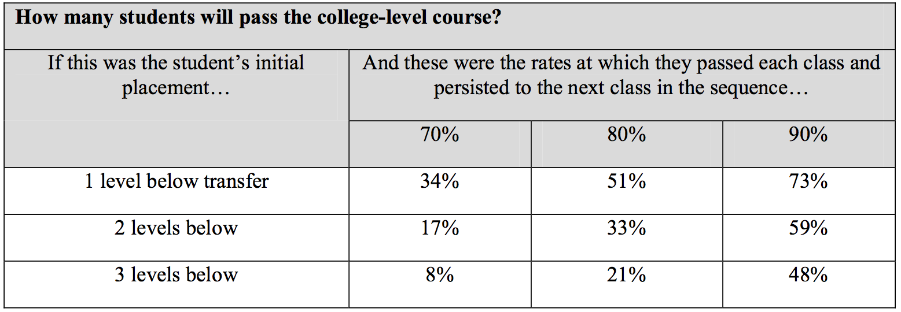
MOTIVATION

Slide 3
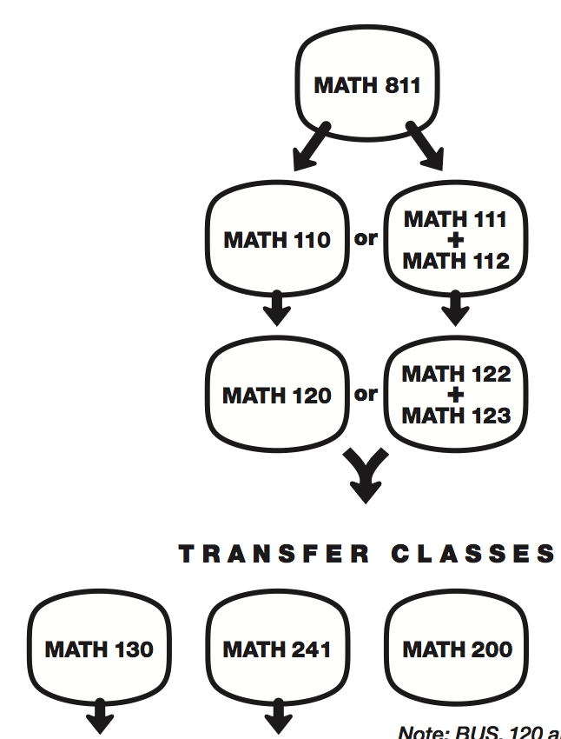


P{P
MATH 190

Slide 4
DATA QUESTION 1
How many students take Math 200, Bus 123, Psych 171 at Skyline (for 08/09-11/12)?
What are the success rates?
How many students had Math 120 as their previous math course?
How is this enrollment disaggregated by ethnicity?

Slide 5
STATS ENROLLMENT AT SKYLINE

Slide 6
SUCCESS RATES

Slide 7
MATH 120 AS PREVIOUS MATH

Slide 9
DATA QUESTION 2
What are the declared majors of our Elementary Algebra students?
Do those majors lead into Statistics?

Slide 10
DECLARED MAJORS OF STUDENTS WHO ENROLLED IN
MATH 110, 111, AND/OR 112 FOR 07/08-11/12
Declared Major | Total - # | Total - %
Undeclared Major AA/AS Degree | 1318 | 22%
Undeclared Major | 1136 | 19%
Nursing | 389 | 6%
Administration of Justice | 238 | 4%
Psychology, General | 176 | 3%
Early Childhood Ed/Child Dev | 153 | 3%
Allied Health | 120 | 2%
Medical Assistant | 95 | 2%
Respiratory Therapy | 78 | 1%
Art | 75 | 1%
CSU GE Cerification | 73 | 1%
Music | 35 | 1%
Physical Education | 35 | 1%
IGETC2 UC Cerification | 34 | 1%
Psychology | 33 | 1%
Early Childhood Education | 32 | 1%
Fashion Design/Merchandising | 31 | 1%
41%
29%

Slide 11
DATA QUESTION 3
What transfer level math classes do former Math 110 students take across the district?
How is this enrollment disaggregated by ethnicity?
What are the success rates?

Slide 13
DISTRICT WIDE MATH 200

Slide 14
DISTRICT WIDE MATH 130

Slide 15
DISTRICT WIDE COMPARISON

Slide 16
SKYLINE MATH 130 – 60 ENROLLED

Slide 17
SKYLINE MATH 200 – 169 ENROLLED

Slide 18
SKYLINE COMPARISON

Slide 19
How many students take the STEM path after succeeding in the STAT path?
COLLEGE | ETHNICITY | SUCCESS IN 120 | ENROLL IN MATH 200 | SUCCESS IN MATH 200 | ENROLL IN MATH 130
CAN | All
CAN | Asian
CAN | Filipino
CAN | Hispanic
CAN | Black
CAN | White
CSM | All
CSM | Asian
CSM | Filipino
CSM | Hispanic
CSM | Black
CSM | White
SKY | All
SKY | Asian
SKY | Filipino
SKY | Hispanic
SKY | Black
SKY | White

Slide 20
How many students take the STEM path after not succeeding in the STAT path?
COLLEGE | ETHNICITY | SUCCESS IN 120 | ENROLL IN MATH 200 | NO SUCCESS IN MATH 200 | ENROLL IN MATH 130
CAN | All
CAN | Asian
CAN | Filipino
CAN | Hispanic
CAN | Black
CAN | White
CSM | All
CSM | Asian
CSM | Filipino
CSM | Hispanic
CSM | Black
CSM | White
SKY | All
SKY | Asian
SKY | Filipino
SKY | Hispanic
SKY | Black
SKY | White

