Slide 1
LEGS Final Project
Bryan Swartout

Slide 2
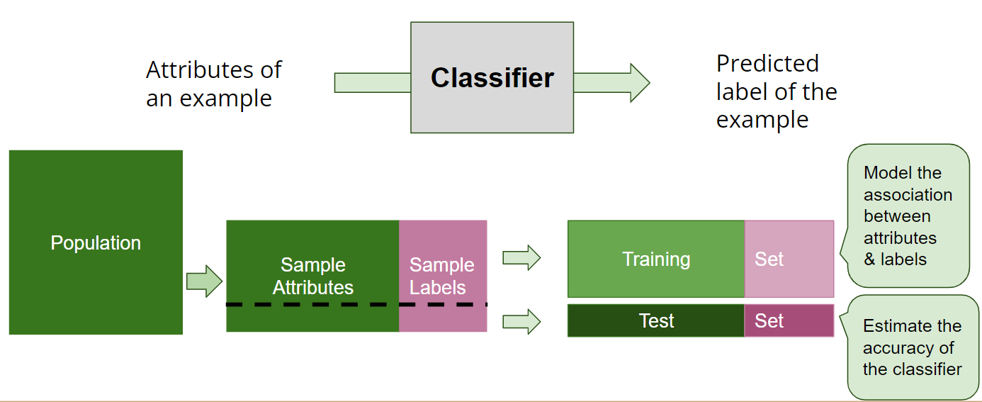
LEGS Final Project - Bryan Swartout @ Skyline
Two commitments:
Support the students’ learning, not the machine’s learning
  The polarizing impact of ChatGPT and other Natural Language Processing algorithms
  Highlighting innovations on assessment
Hosting/facilitating workshops on AI / ML. Some activities to use:
  Quick,Draw!
  Survival of the Best Fit

Slide 3
LEGS Final Project - Bryan Swartout @ Beyond
Professional Career
  Continue learning to hold AI/ML (as a discipline) accountable
  AI/ML also relies on data, ensure that the training and test data is vetted through the lens of equity/advocacy
Activism / Social Interactions
  Contribute and participate in discussion spaces that empower perspectives that remain critical of the impacts of AI/ML

